Slide 1
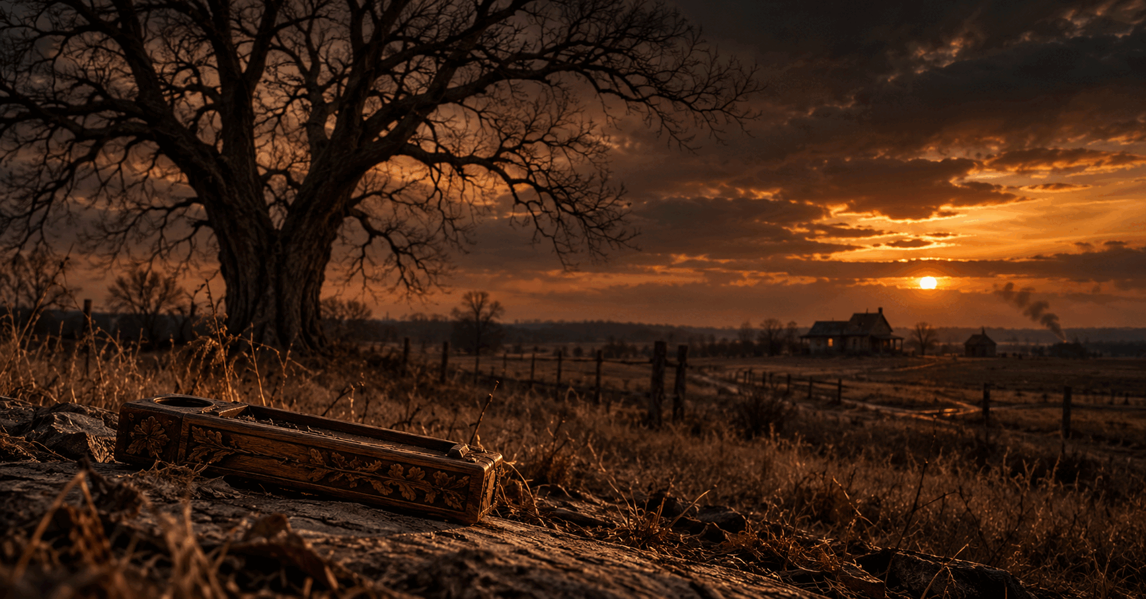
THE TREE
MAUD 1898
A historical thriller inspired by a documented Oklahoma tragedy
Feature film with limited series potential
Based on a true story

Slide 2
WHAT IS THE TREE
A true crime story that becomes a fight over memory.
LOGLINE
After a killing in Oklahoma Territory triggers false accusations and mob violence, a modern discovery forces two Seminole teenagers to confront the record their town buried and the family memory that never disappeared.
FORMAT
A feature length historical thriller with a present day frame and limited series potential.
REDDYHOUSE PRODUCTIONS THE TREE 1898
01

Slide 3
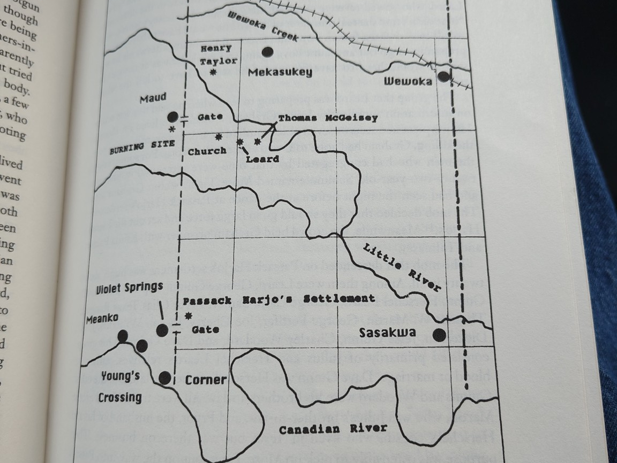
THE DOCUMENTED FOUNDATION
The film begins with the record and dramatizes with discipline.
1898
Mary Leard is murdered outside the rural home where her family is living. Accusations spread through the community. Lincoln McGeisey and Palmer Sampson become the targets of a mob.
THE AFTERMATH
Federal investigation, press accounts and Seminole Nation records leave a trail. The truth survives in fragments while the violence reshapes every family connected to it.
REDDYHOUSE PRODUCTIONS THE TREE 1898
02

Slide 4
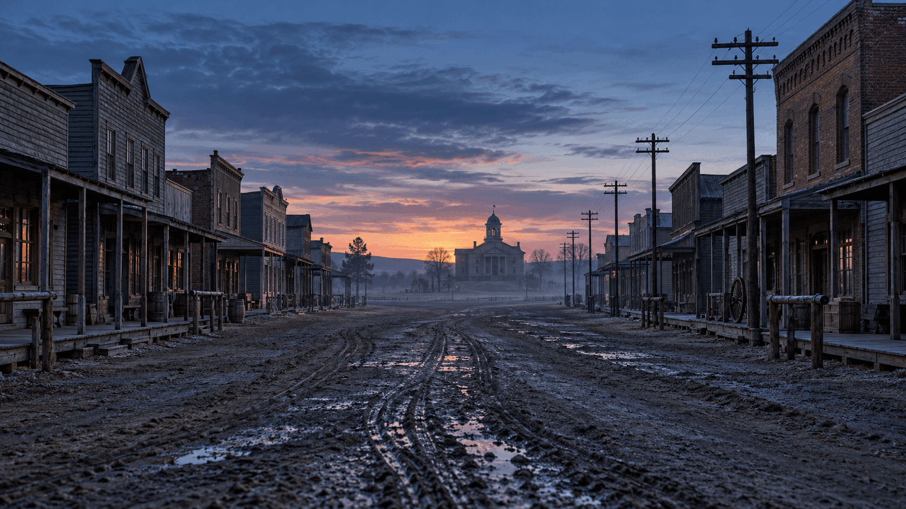
THE STORY
Two timelines lead to the same wound.
THE PAST
The murder, the accusations, the pursuit and the mob unfold in exact sequence as fear replaces evidence.
THE PRESENT
Rebecca and Lee find an object tied to Maud in 1898. Their search turns a family mystery into a confrontation with the official record.
REDDYHOUSE PRODUCTIONS THE TREE 1898
03

Slide 5
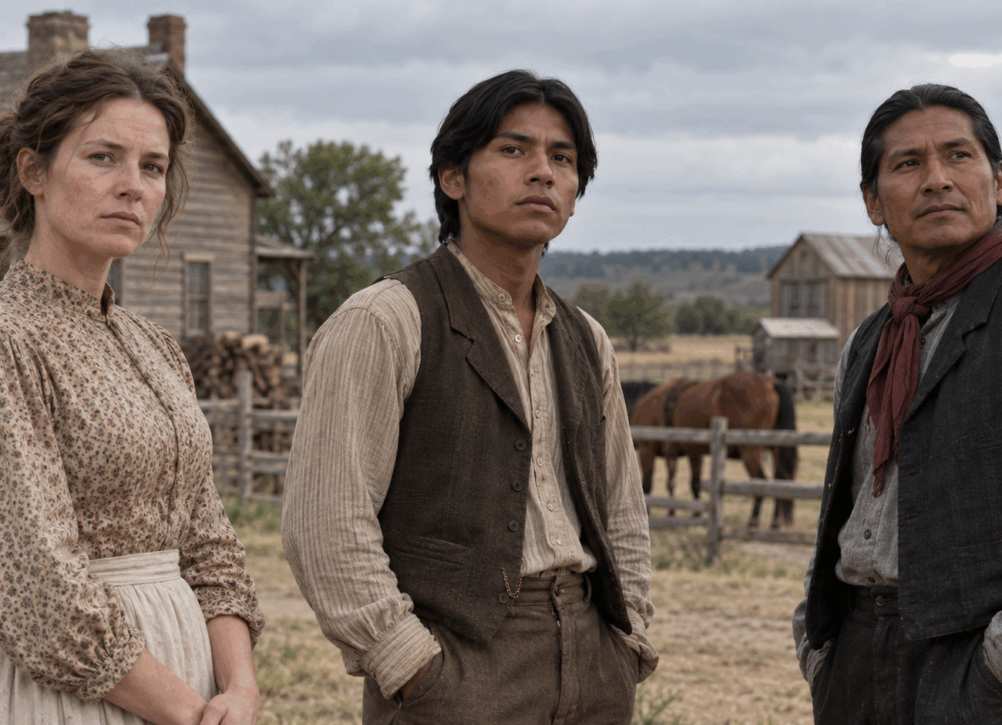
MARY AND LINCOLN
The human cost comes before the history lesson.
MARY LEARD
A wife and mother whose death becomes the spark for accusations that move faster than proof.
LINCOLN MCGEISEY
A young Seminole man trapped inside a story that others decide to tell about him. His flight and capture drive the historical timeline.
REDDYHOUSE PRODUCTIONS THE TREE 1898
04

Slide 6
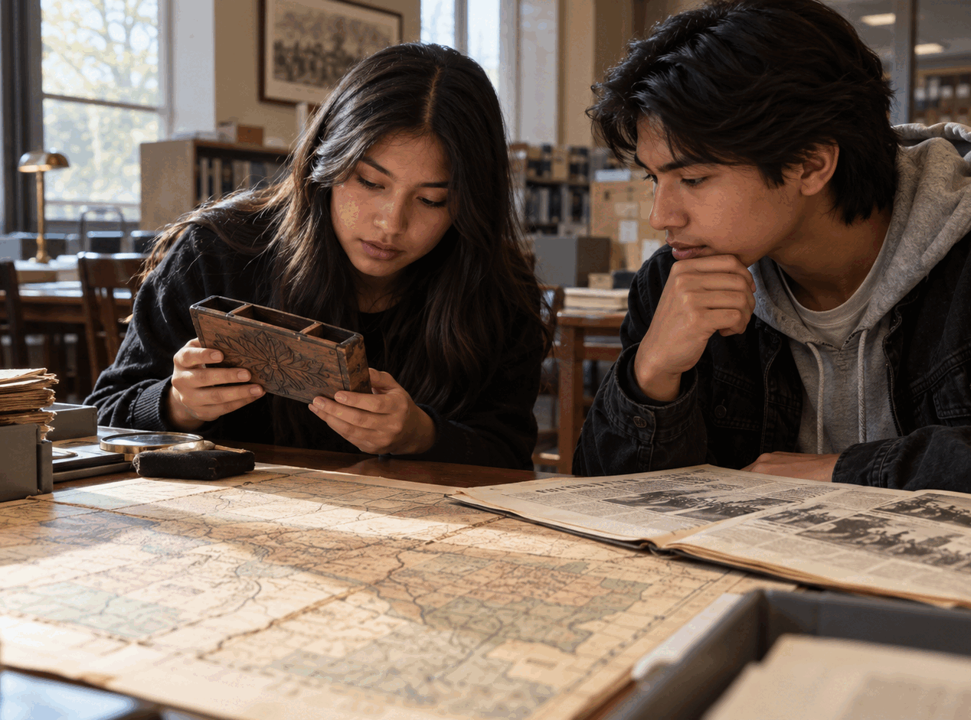
REBECCA AND LEE
The present day story gives the audience a way into the record.
REBECCA JAMES
A present day investigator whose discovery of a pen holder engraved with The Tree and Maud 1898 opens the buried story.
LEE
Rebecca’s companion in the search. Their questions connect public history with family memory and force the town to look again.
REDDYHOUSE PRODUCTIONS THE TREE 1898
05

Slide 7
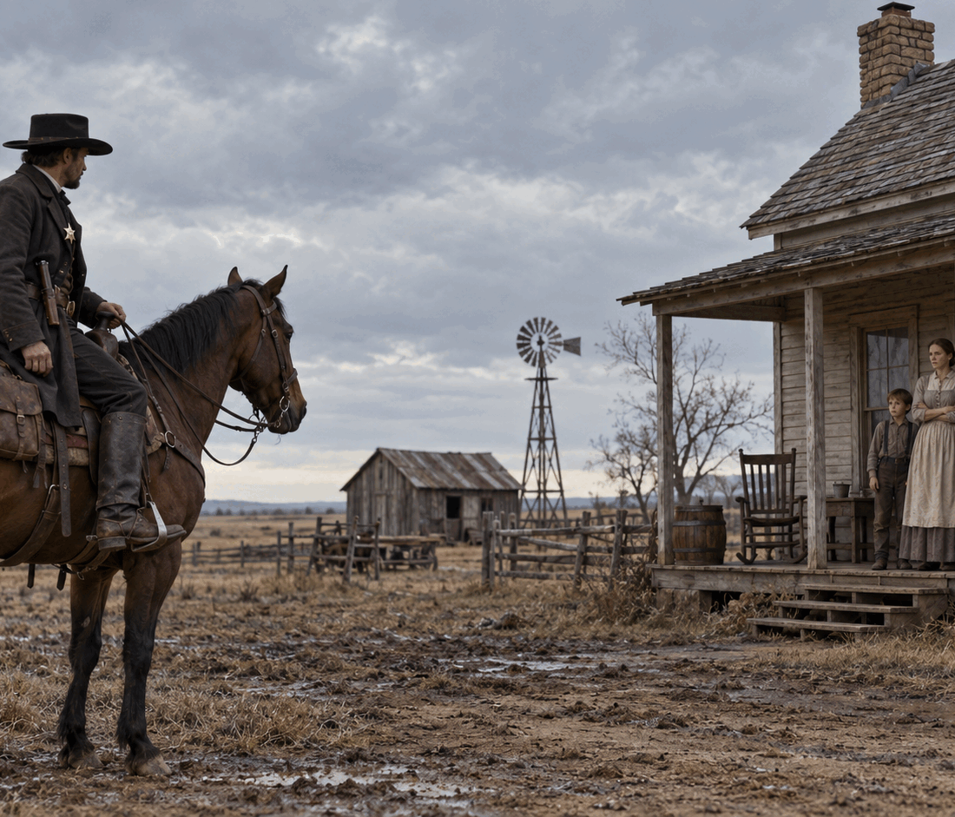
THE PEOPLE AROUND THE CASE
Every choice moves the story closer to the mob.
GEORGE PETTIFER
The messenger who tells Julius that something has happened to Mary.
PALMER SAMPSON
The second Seminole man swept into the accusations and the violence that follows.
THE INVESTIGATORS
Marshal Thompson and the federal inquiry expose the distance between rumor, newspaper certainty and evidence.
REDDYHOUSE PRODUCTIONS THE TREE 1898
06

Slide 8
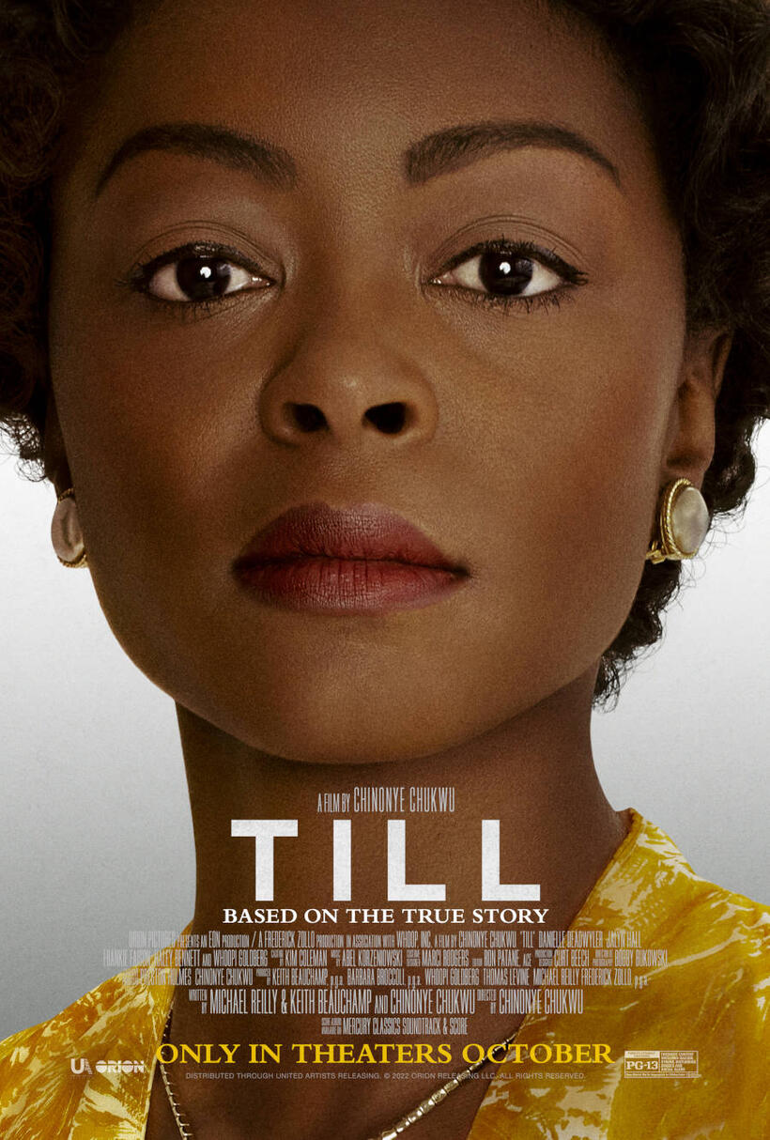
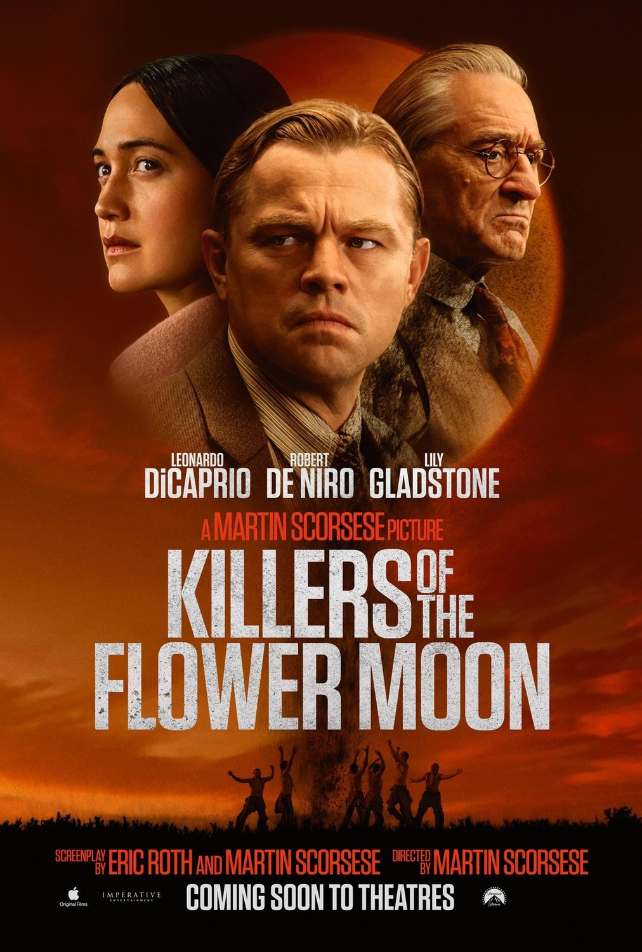
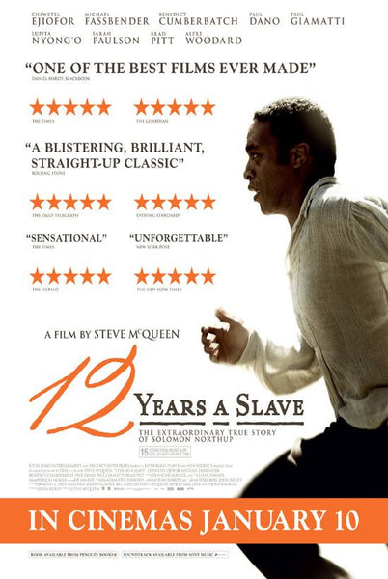
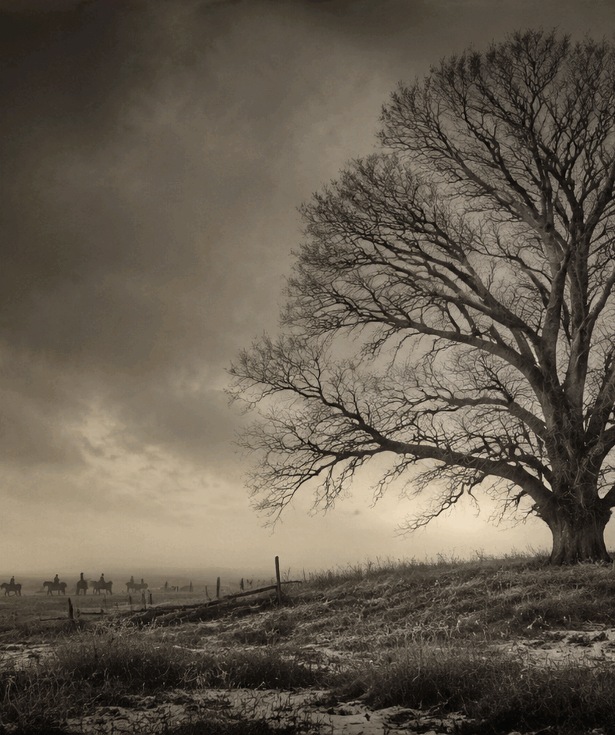
MOOD AND TONE
Historical suspense with emotional restraint.
TILL
KILLERS OF THE FLOWER MOON
12 YEARS A SLAVE
Family grief gives history an immediate human center.
A criminal record reveals the system surrounding the violence.
Historical detail stays grounded in personal survival.
REDDYHOUSE PRODUCTIONS THE TREE 1898
07
Notes:
Comparison poster sources. Fandango Till. IMP Awards Killers of the Flower Moon. GFD Film Library 12 Years a Slave.

Slide 9
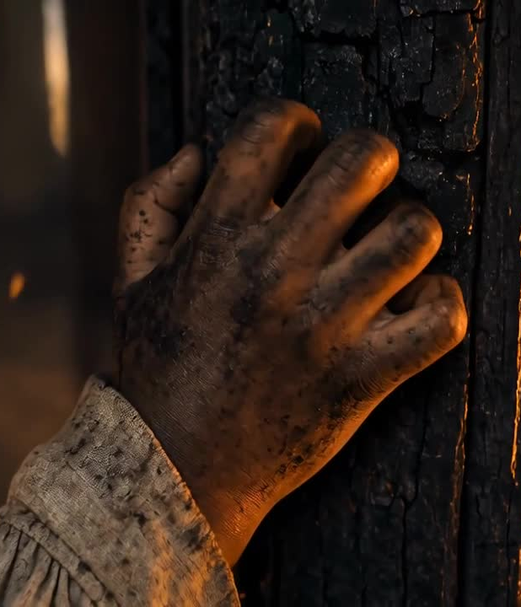
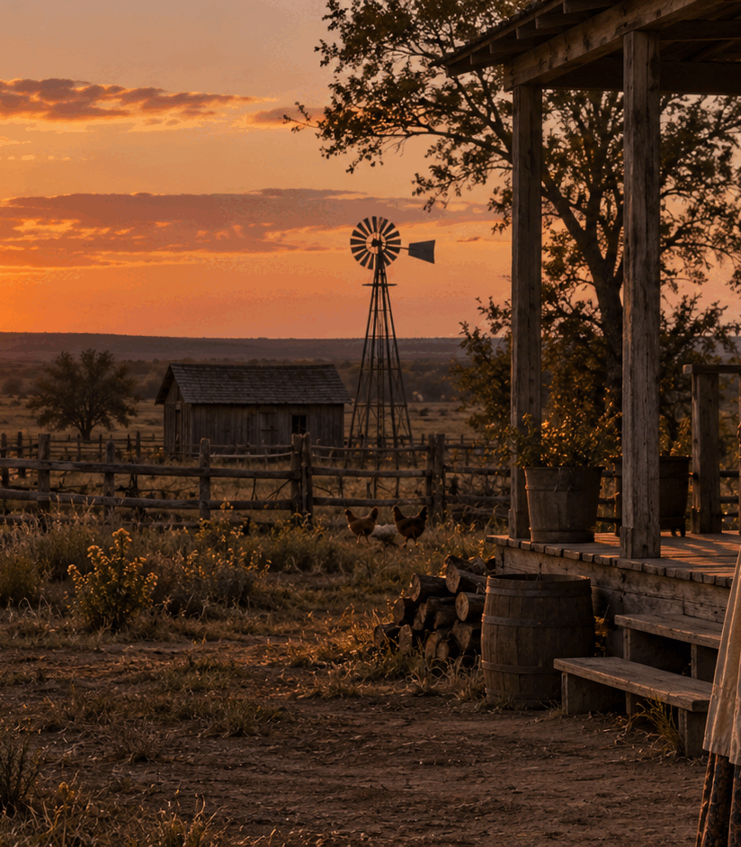
VISUAL LANGUAGE
The past feels immediate without turning violence into spectacle.
Firelight marks the violence. Empty streets carry the fear. The ruined home shows what remained after the mob moved on.
REDDYHOUSE PRODUCTIONS THE TREE 1898
08

Slide 10
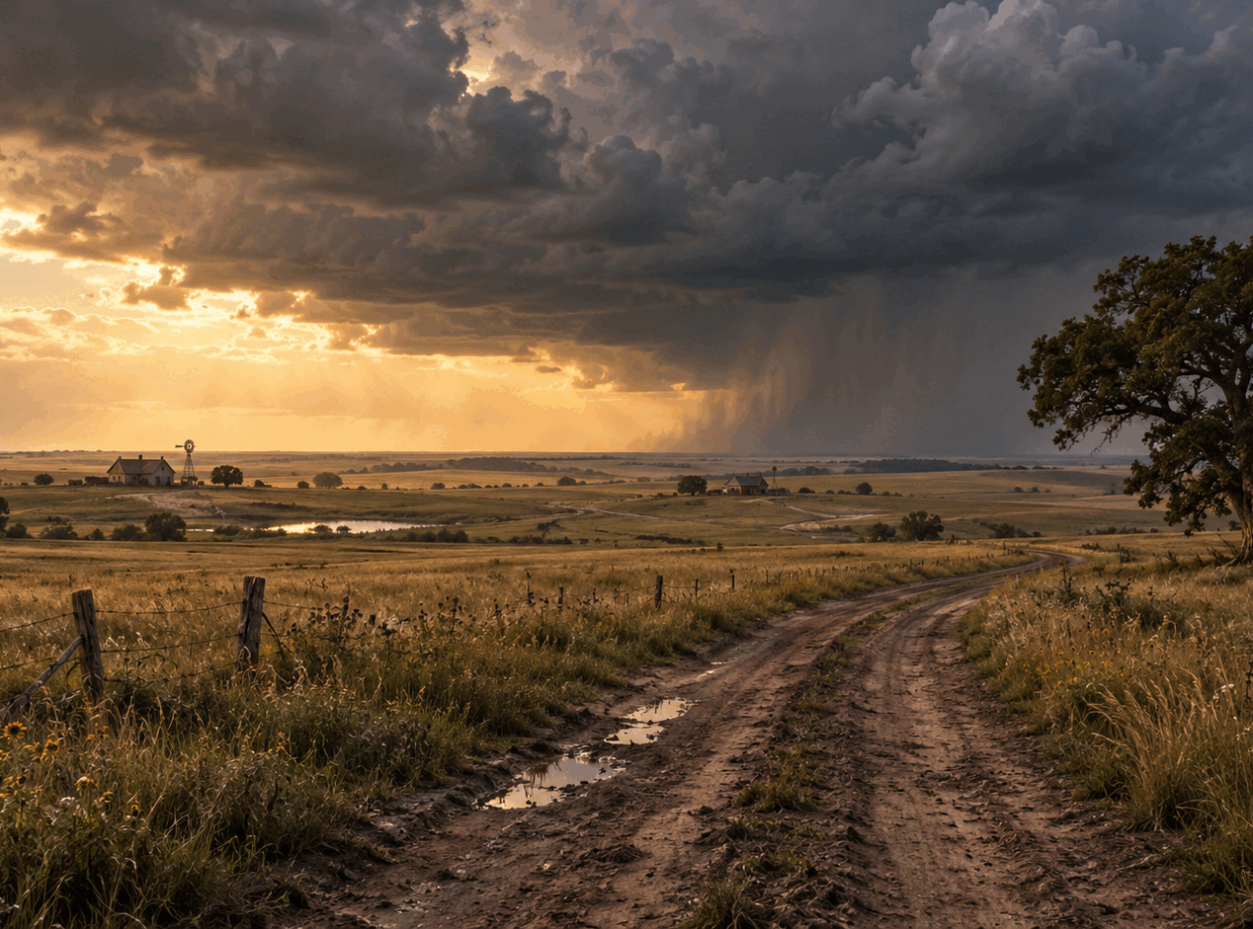
AUDIENCE
A regional story with national historical reach.
PRIMARY AUDIENCE
Adults who support historical drama, true crime and stories about race, law and contested memory.
COMMUNITY AUDIENCE
Viewers connected to Oklahoma history, Seminole history, African American history and family research.
REDDYHOUSE PRODUCTIONS THE TREE 1898
09

Slide 11
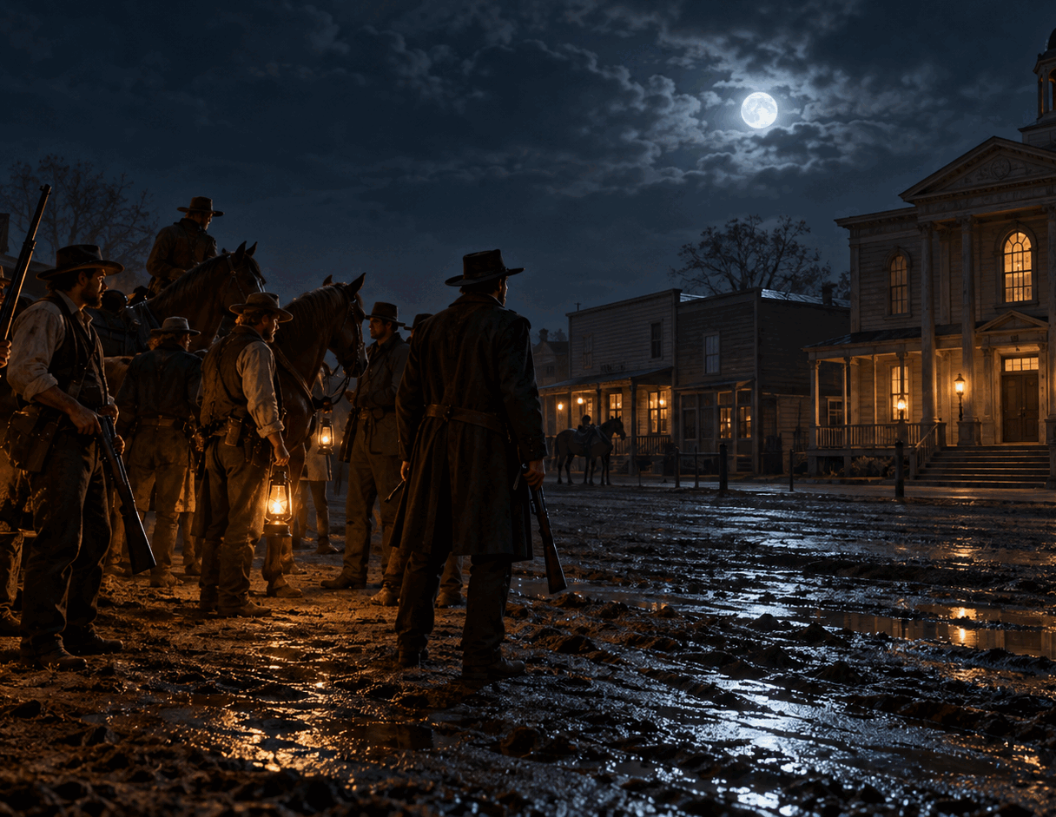
PRODUCTION APPROACH
A disciplined independent period production.
BUILD THE WORLD
A limited number of period locations, controlled crowd days and a consistent visual plan keep the production focused.
PROTECT THE HISTORY
Research review, cultural consultation and clear separation between documented fact and dramatized private moments guide the screenplay and production.
REDDYHOUSE PRODUCTIONS THE TREE 1898
10

Slide 12
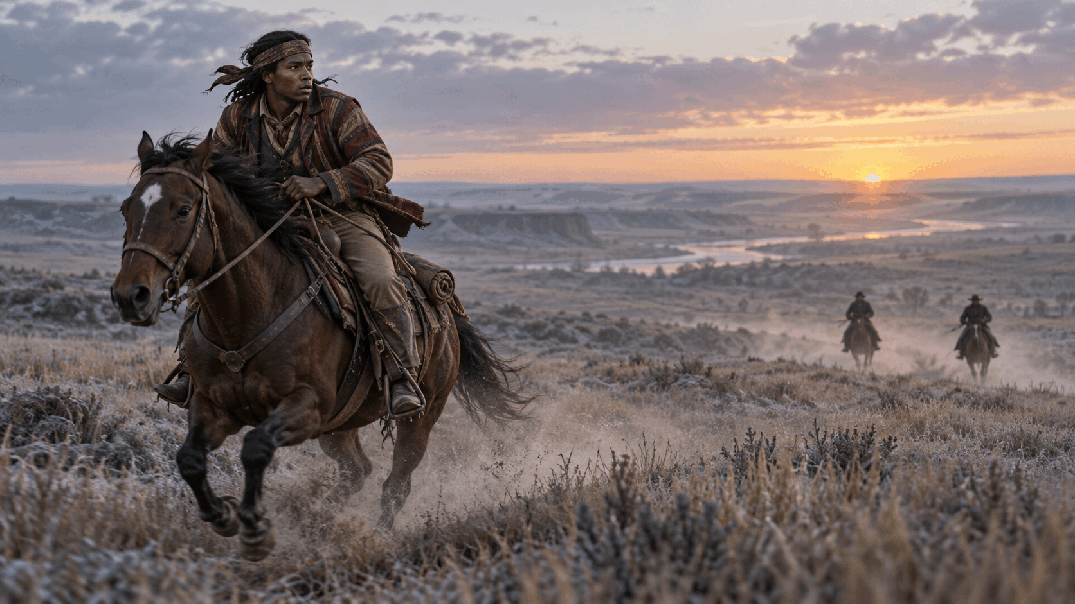
DEVELOPMENT POSITION
The package grows from a researched screenplay and a clear visual plan.
FEATURE
$5M to $9M
Working development range
Final budget follows the locked screenplay, location plan and department estimates.
REDDYHOUSE PRODUCTIONS THE TREE 1898
11

Slide 13
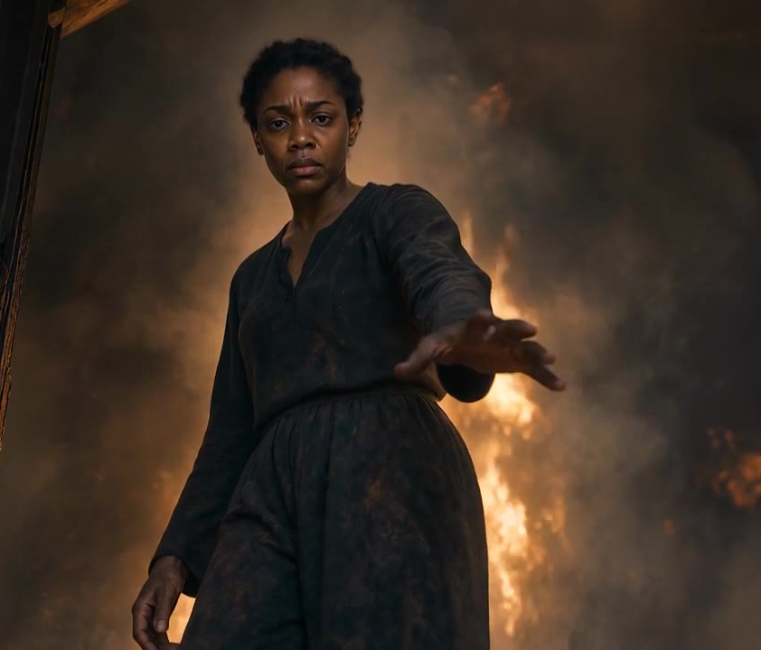
WHY THIS FILM
The record exists. The story has not reached the screen.
THE OPPORTUNITY
The film brings a little known Oklahoma case into a character driven mystery that can reach historical drama viewers, true crime audiences and communities whose family histories rarely receive this scale of attention.
THE RESPONSIBILITY
The production must earn trust through research, restraint and direct engagement with the people closest to the history.
REDDYHOUSE PRODUCTIONS THE TREE 1898
12

Slide 14
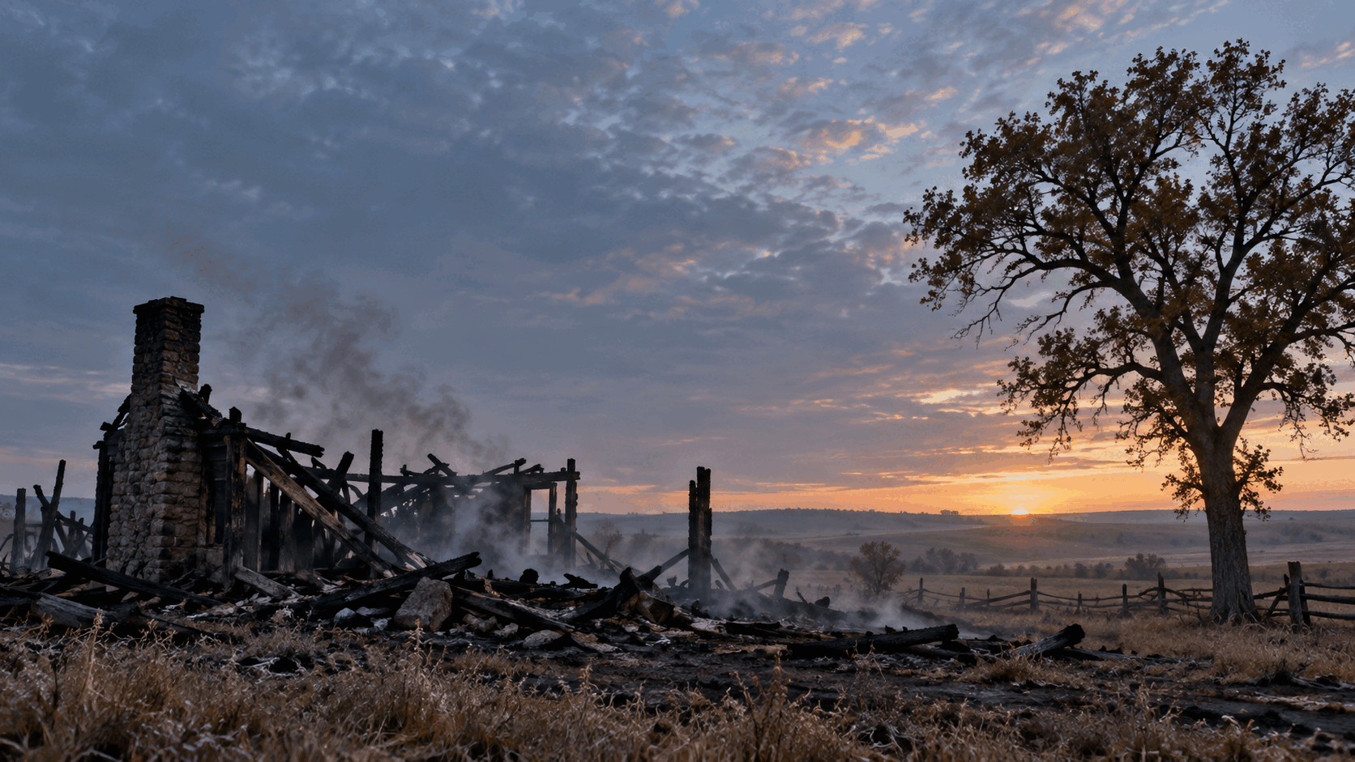
THE ASK
Help bring the buried record to the screen.
Seeking a producing partner
Historical and cultural advisors
Development financing
Packaging and distribution guidance
OG Harve
Writer and Producer
Reddyhouse Productions
reddyhouseproductions.com
thetree1898.com

