Slide 1
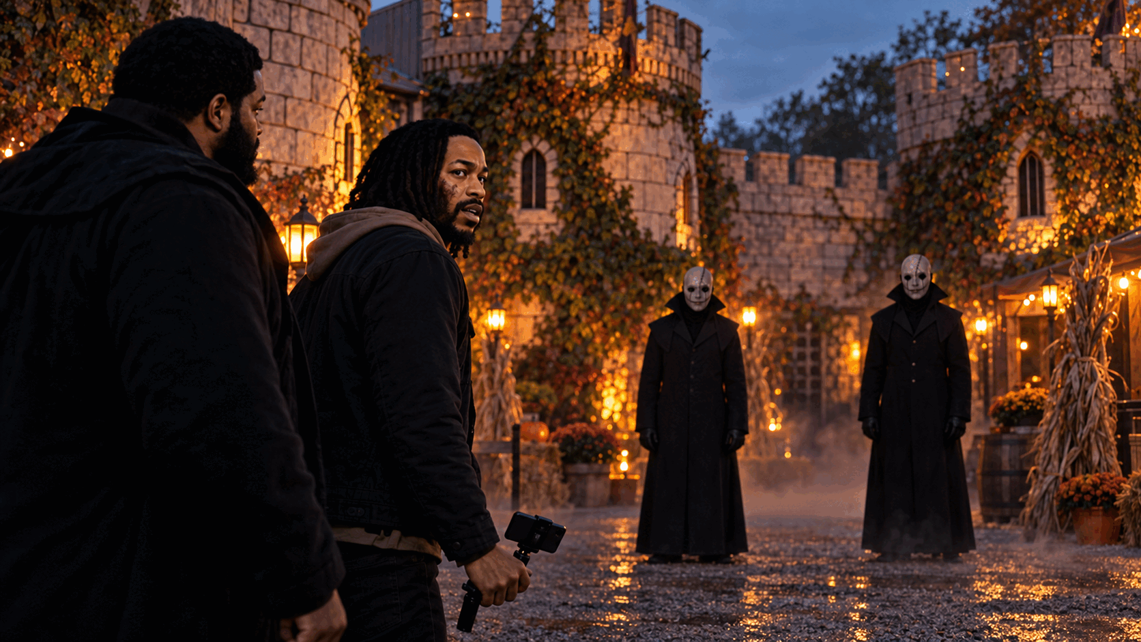
THE
RED
THREADS
A character driven haunted castle slasher
Feature film
Proof of concept in development
Notes:
Reddyhouse Productions original project. Visual development imagery.

Slide 2
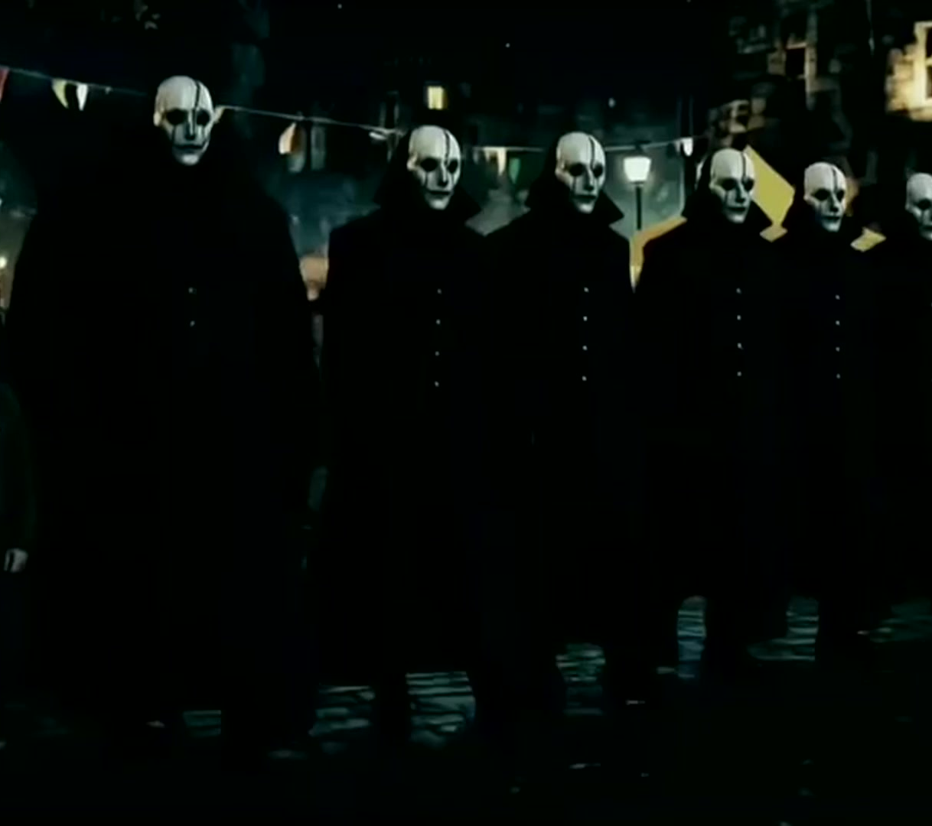
THE HOOK
The audience sees a show. The killer sees cover.
LOGLINE
When a struggling cameraman and his singer best friend take seasonal jobs at a sprawling Halloween attraction, they capture evidence of a murder and discover that matching costumes let a killer move through the crowd without being seen.
THE PROMISE
A social slasher built around friendship, backstage chaos and the fear that the person beside you may be wearing someone else’s face.
REDDYHOUSE PRODUCTIONS THE RED THREADS
01

Slide 3
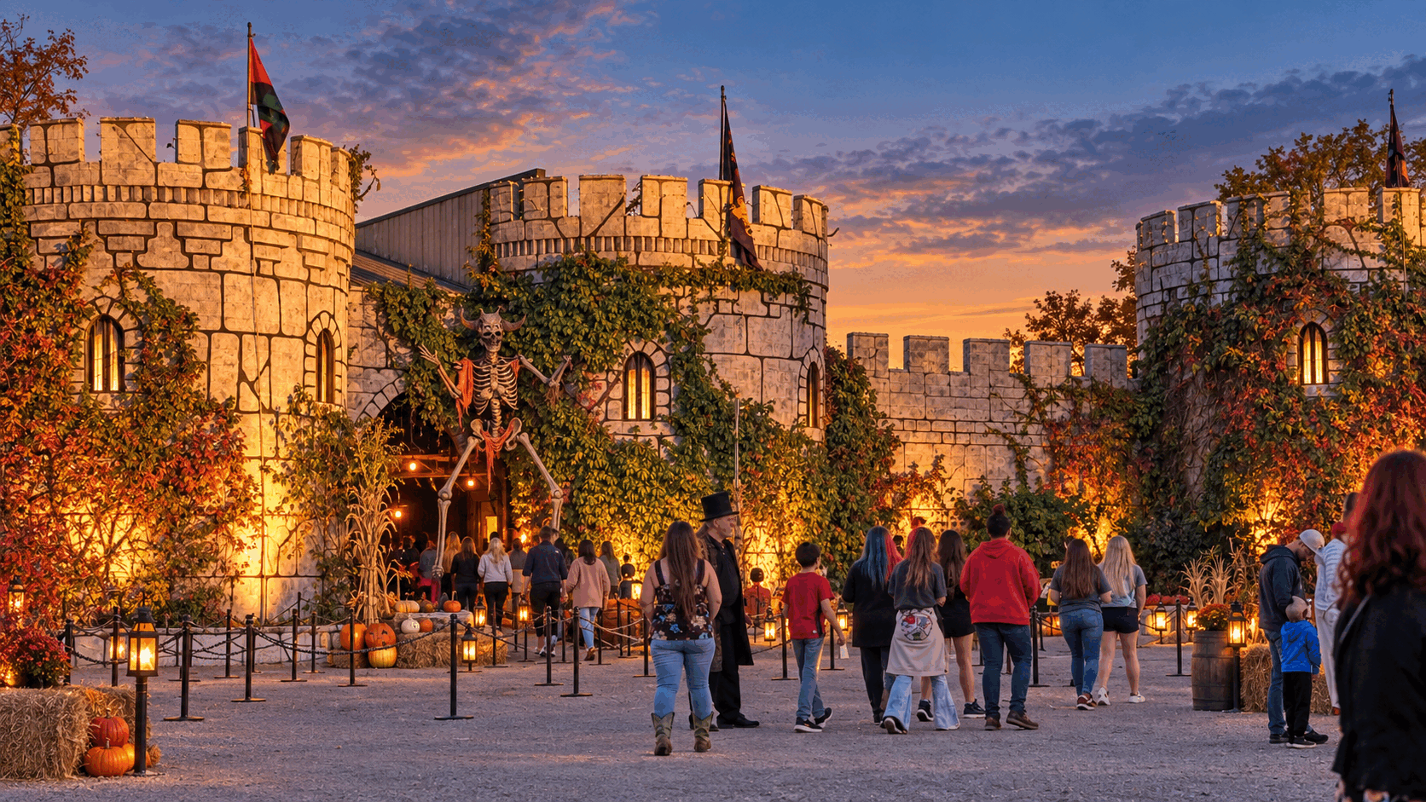
THE WORLD
The Haunted Castle gives the story its engine.
TWO NIGHTS
Night one plants the murders inside a working attraction. Night two turns every performer, guest and dark passage into a possible threat.
REAL PRODUCTION VALUE
The Castle of Muskogee offers towers, pathways, performance spaces and crowds that already feel cinematic. Location access is tentatively agreed pending final paperwork.
REDDYHOUSE PRODUCTIONS THE RED THREADS
02

Slide 4
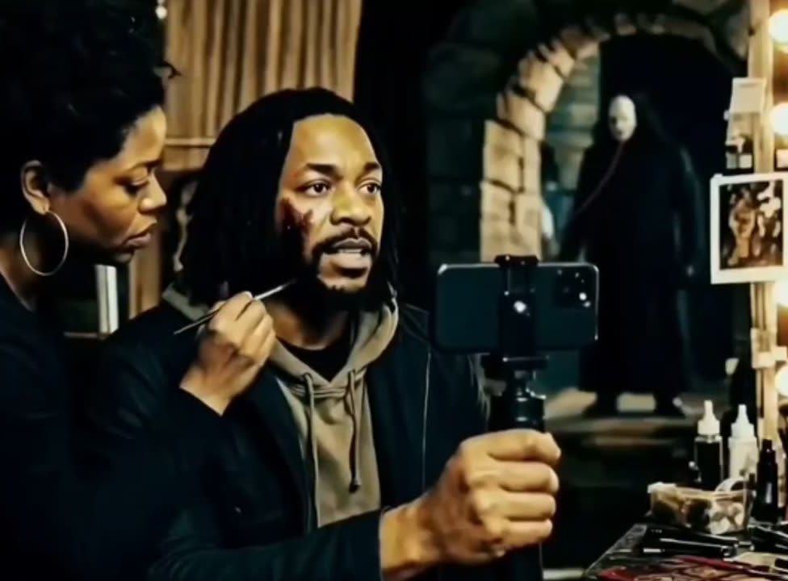
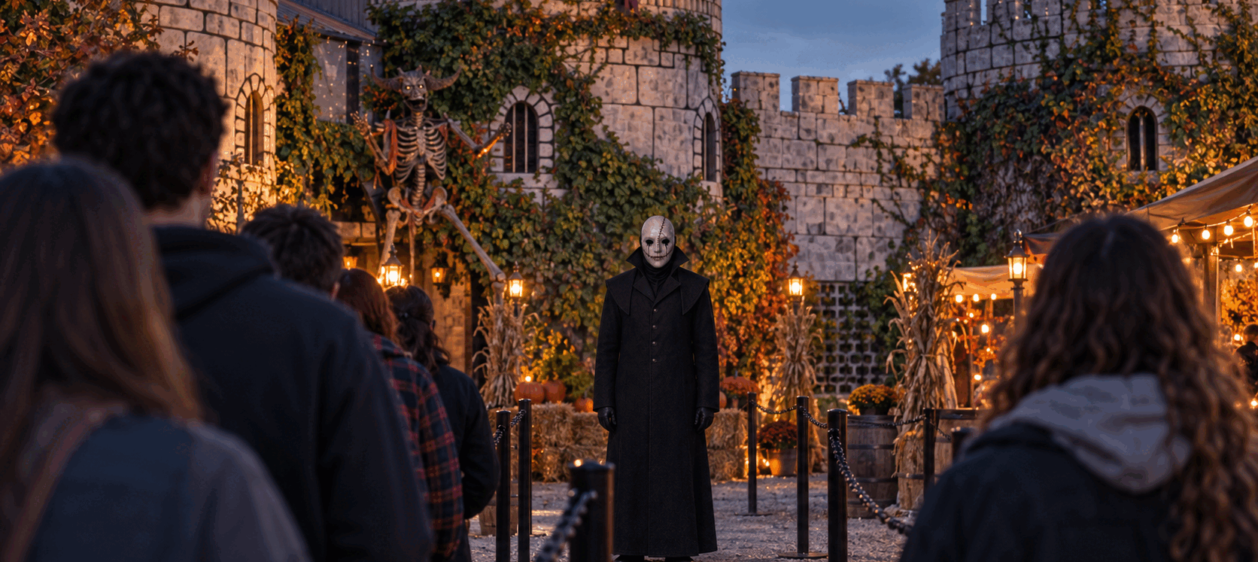
NATE COLE
A cameraman who notices what everyone else misses.
CHARACTER
Nate is a rapper, video creator and new in park cameraman. His camera records a body being dragged after the attraction closes. By morning the trail remains, but the body is gone.
REDDYHOUSE PRODUCTIONS THE RED THREADS
03

Slide 5
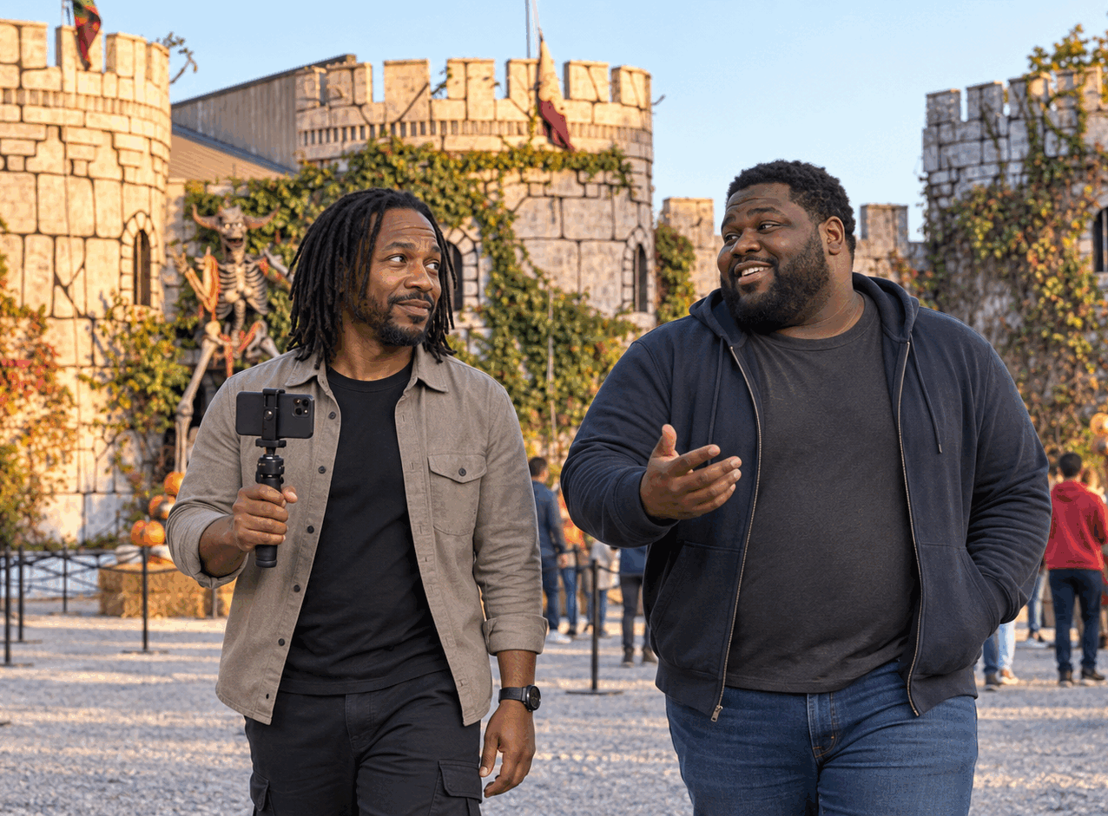
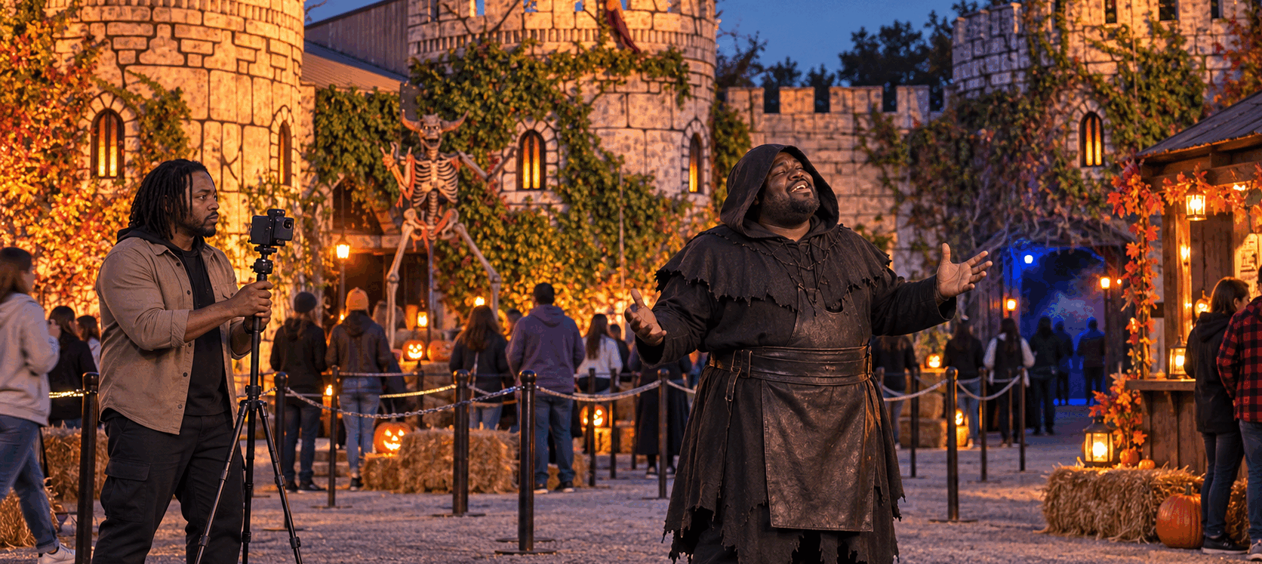
MIKE MERCER
The bigger presence with the warmest voice in the room.
CHARACTER
Mike is an R and B and gospel singer working as the Executioner. He needs the job, wants to rebuild trust with Shelly and keeps Nate grounded when the footage turns their seasonal gig into a nightmare.
REDDYHOUSE PRODUCTIONS THE RED THREADS
04

Slide 6
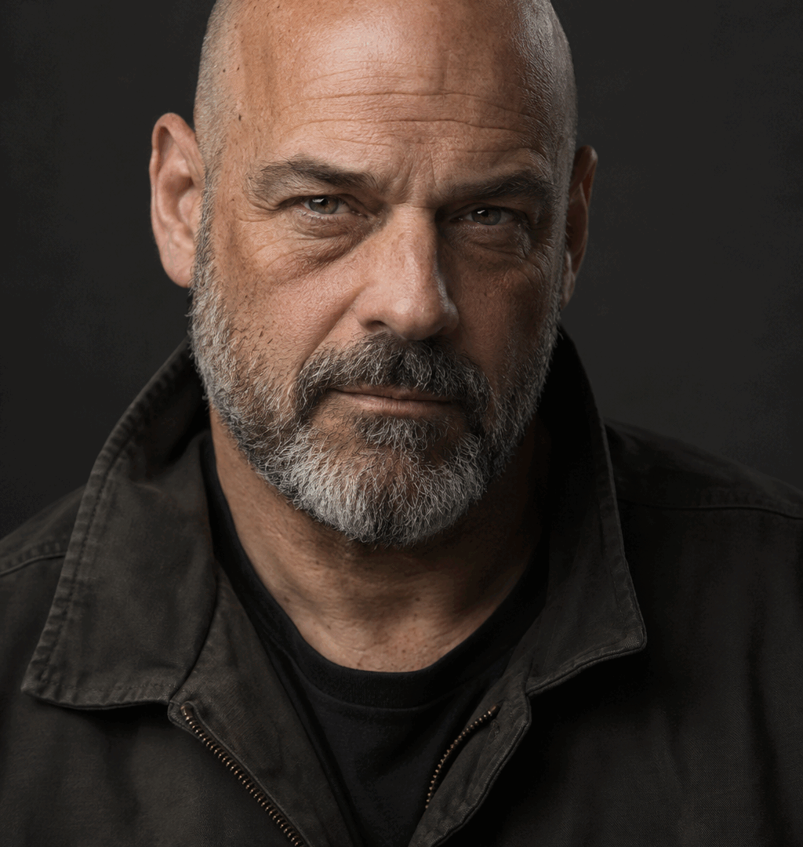
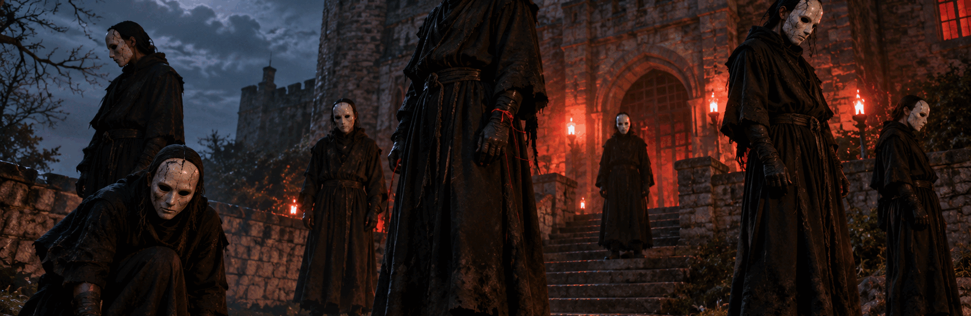
BERNIE AND THE RED THREADS
The suspects already belong in the dark.
BERNIE
THE RED THREADS
A snake keeper whose grief and private rituals make him impossible to dismiss.
Seven performers share the same mask and costume. Only six have assigned roles. The missing identity becomes the film’s central visual clue.
REDDYHOUSE PRODUCTIONS THE RED THREADS
05

Slide 7
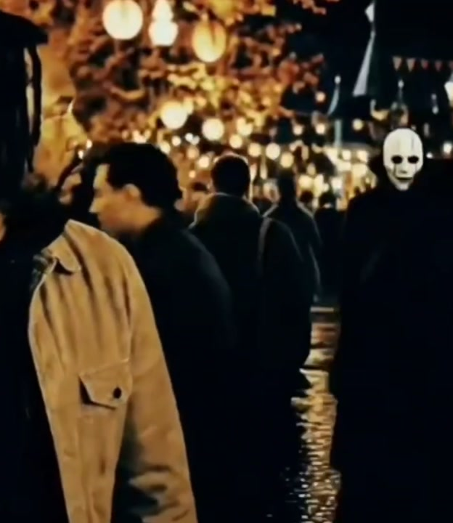
STORY MOVEMENT
The mystery tightens while the attraction stays open.
NIGHT ONE
THE MORNING AFTER
Nate and Mike settle into the job. A violent encounter disappears into the noise of the attraction. Nate’s camera sees more than he does.
The footage shows a body drag. Nate and Mike follow the route. The trail ends with no body and no witness willing to admit what they saw.
NIGHT TWO
The castle opens again. Every matching costume creates a fresh suspect while separate secrets make the truth harder to isolate.
REDDYHOUSE PRODUCTIONS THE RED THREADS
06

Slide 8
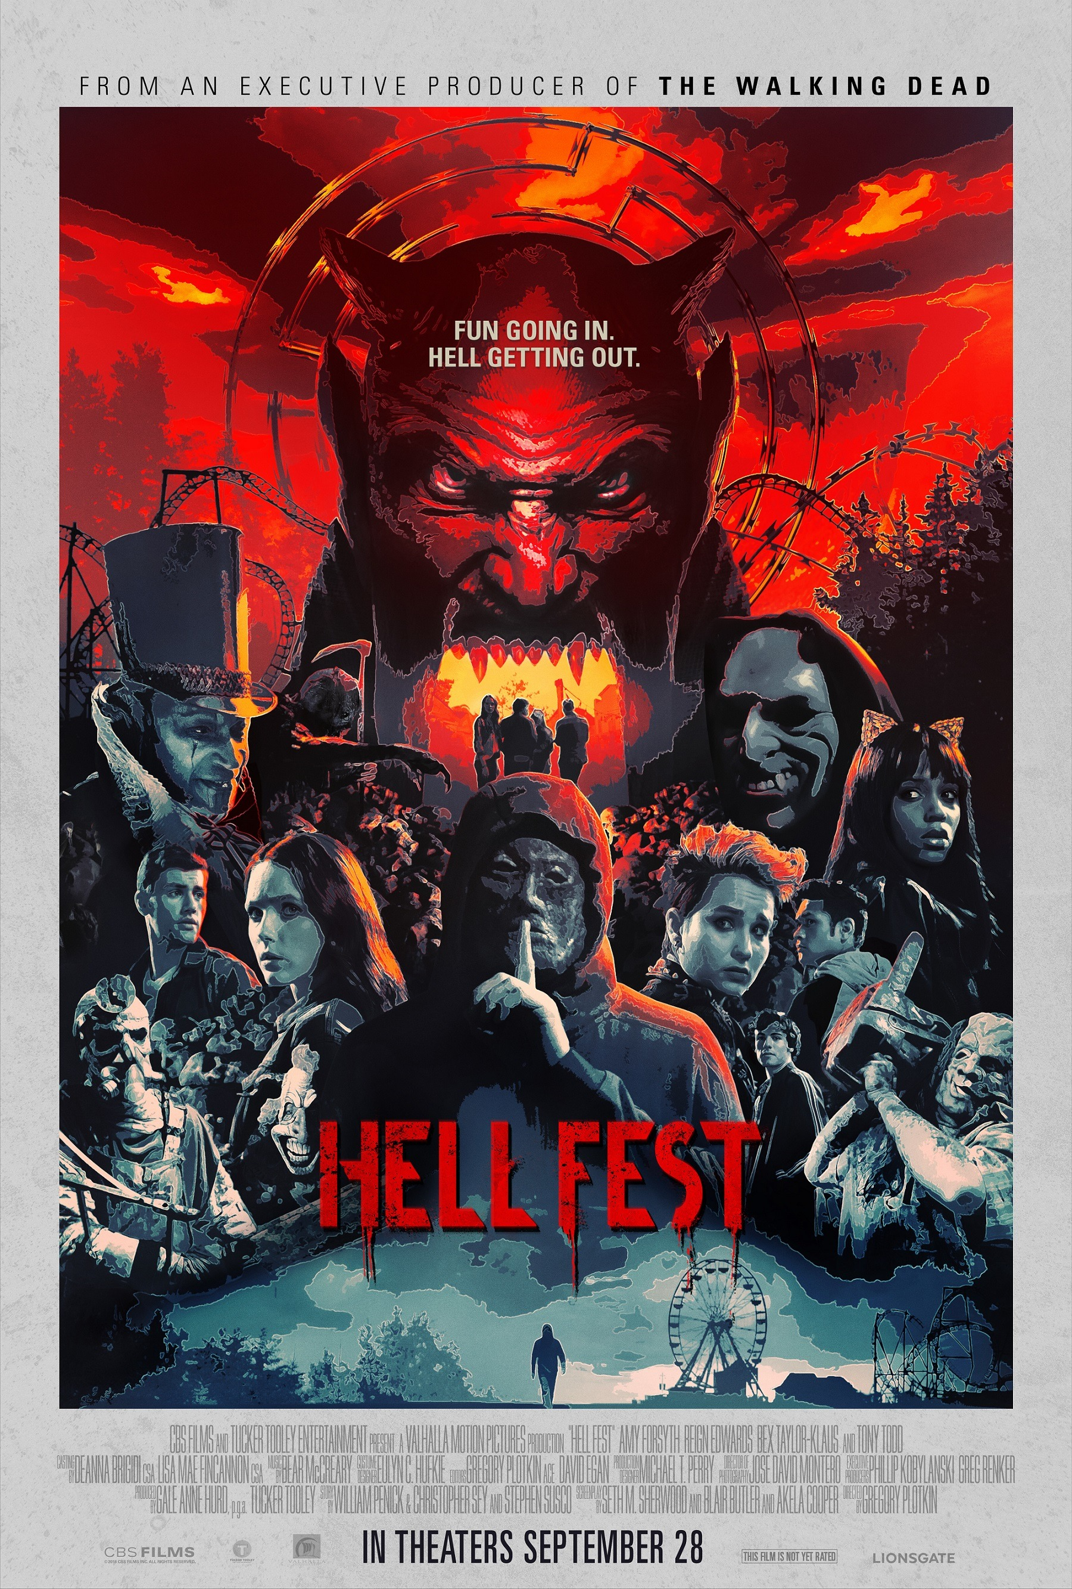
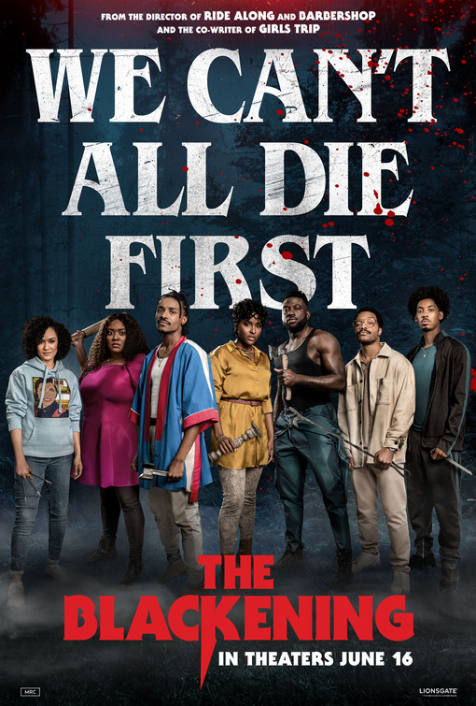
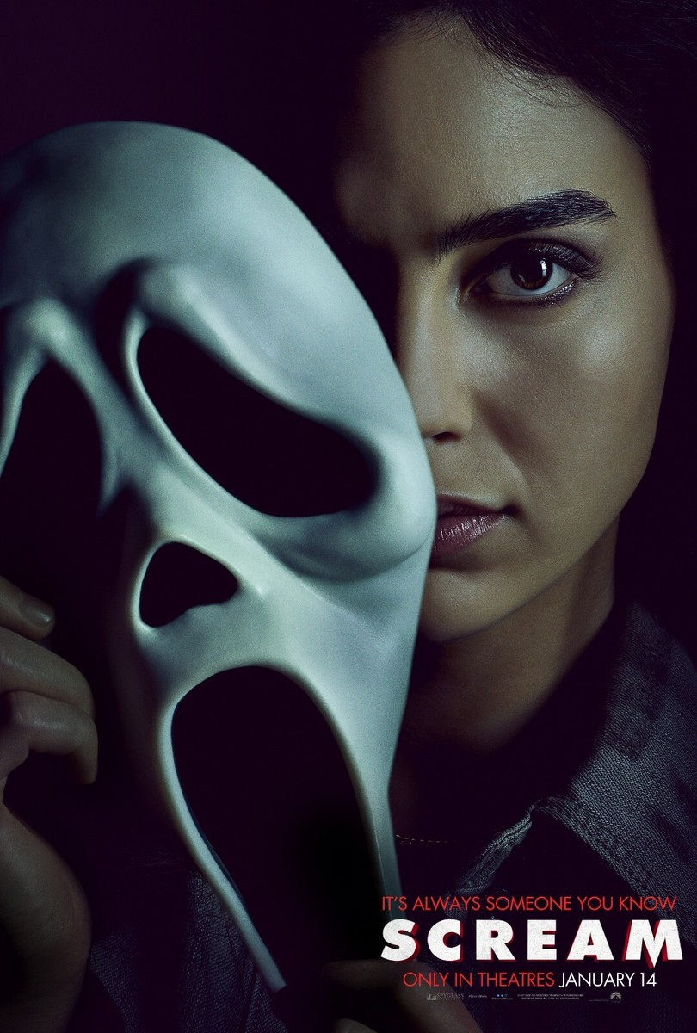
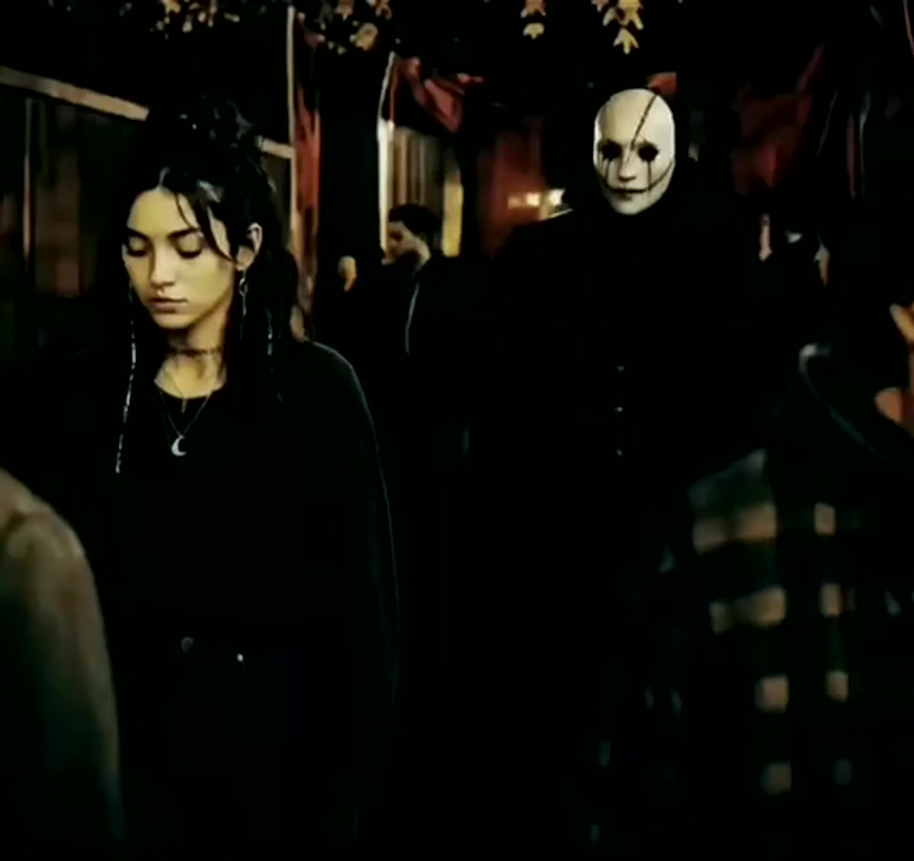
MOOD AND TONE
A slasher with tension, humor and a crowded social world.
HELL FEST
THE BLACKENING
SCREAM
A working attraction gives danger a place to hide.
Black friendship and humor shape the point of view.
Suspicion travels through a cast that knows the rules.
REDDYHOUSE PRODUCTIONS THE RED THREADS
07
Notes:
Comparison posters used for private pitch reference. Hell Fest. The Blackening. Scream.

Slide 9
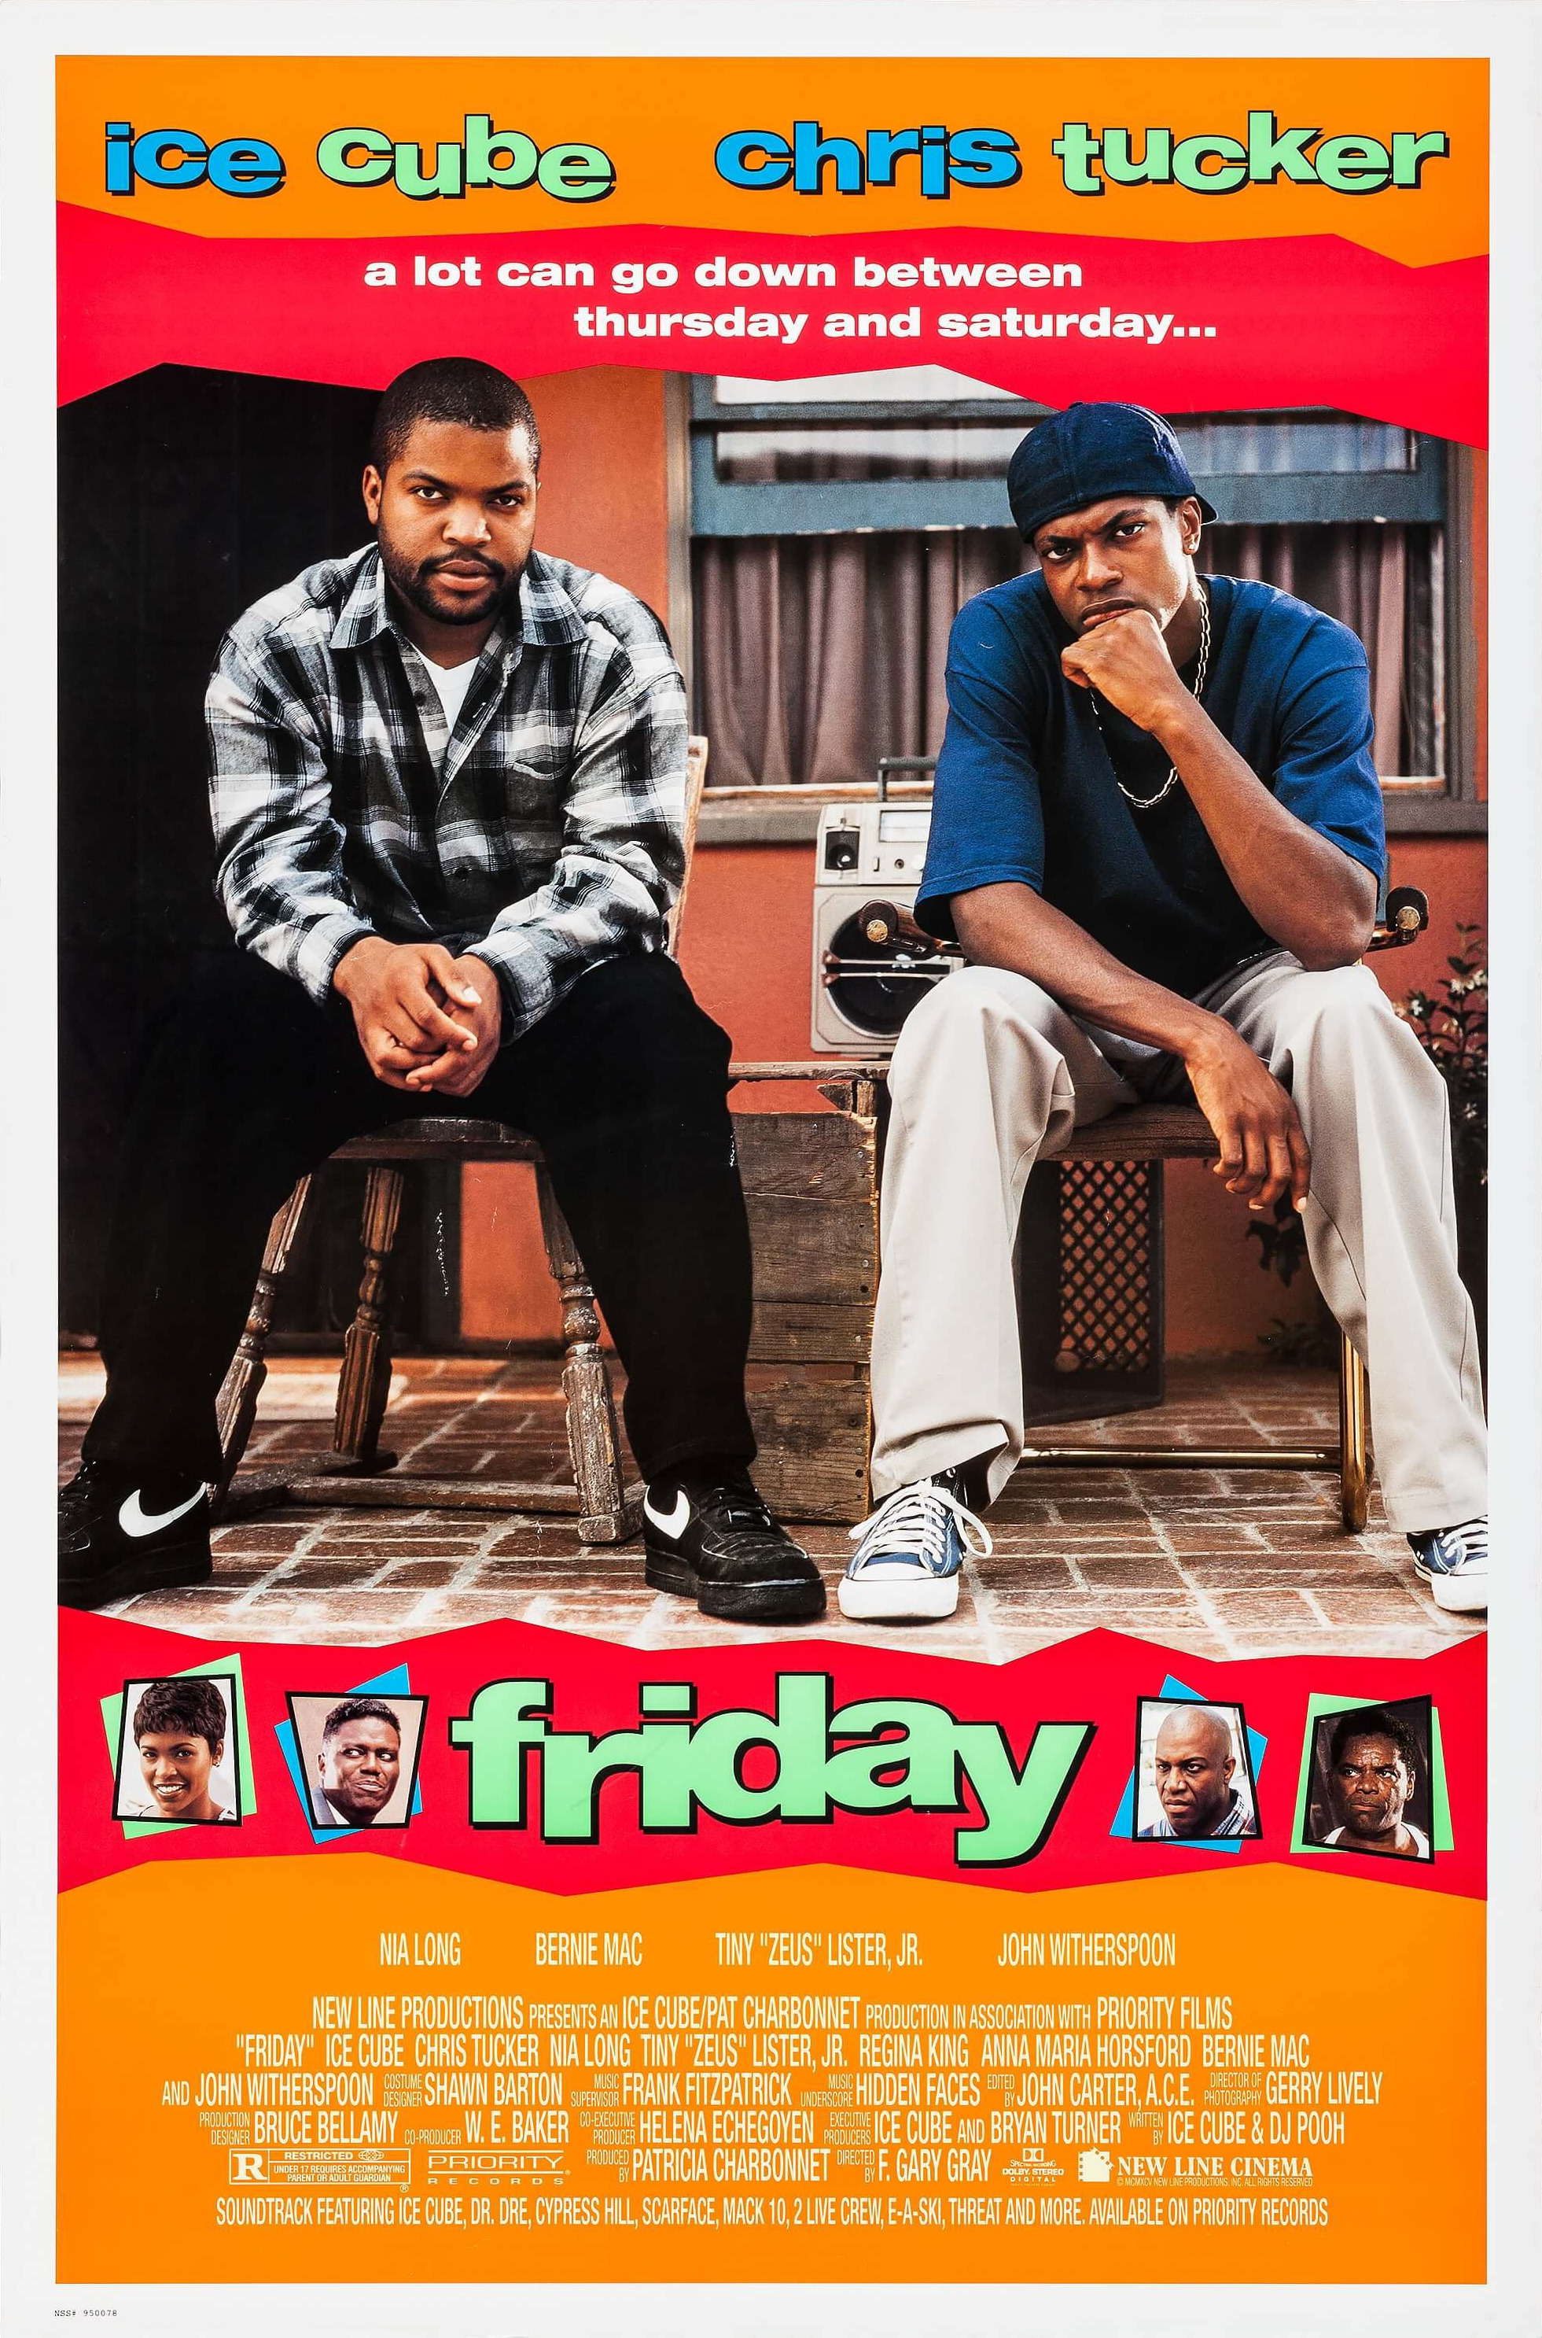
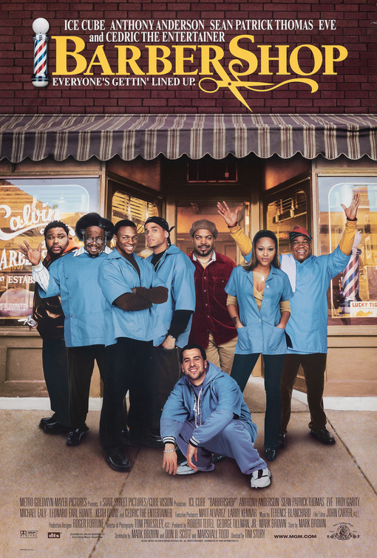
THE COMEDY
Nate and Mike keep the audience inside the fear.
THE RHYTHM
Their humor comes from history, frustration and the way close friends talk when panic gives them no time to perform for anyone else.
THE BALANCE
The friendship stays funny because it is specific. The danger stays real because the joke never erases the consequence.
REDDYHOUSE PRODUCTIONS THE RED THREADS
08

Slide 10
AUDIENCE
A theatrical horror film with an event ready setting.
PRIMARY AUDIENCE
Horror viewers ages 18 to 39 who see scary movies as a group experience.
SECONDARY AUDIENCE
Black moviegoers and viewers drawn to character driven genre films with comedy, mystery and repeatable mythology.
RELEASE LANE
Halloween theatrical play followed by streaming and home entertainment.
REDDYHOUSE PRODUCTIONS THE RED THREADS
09

Slide 11
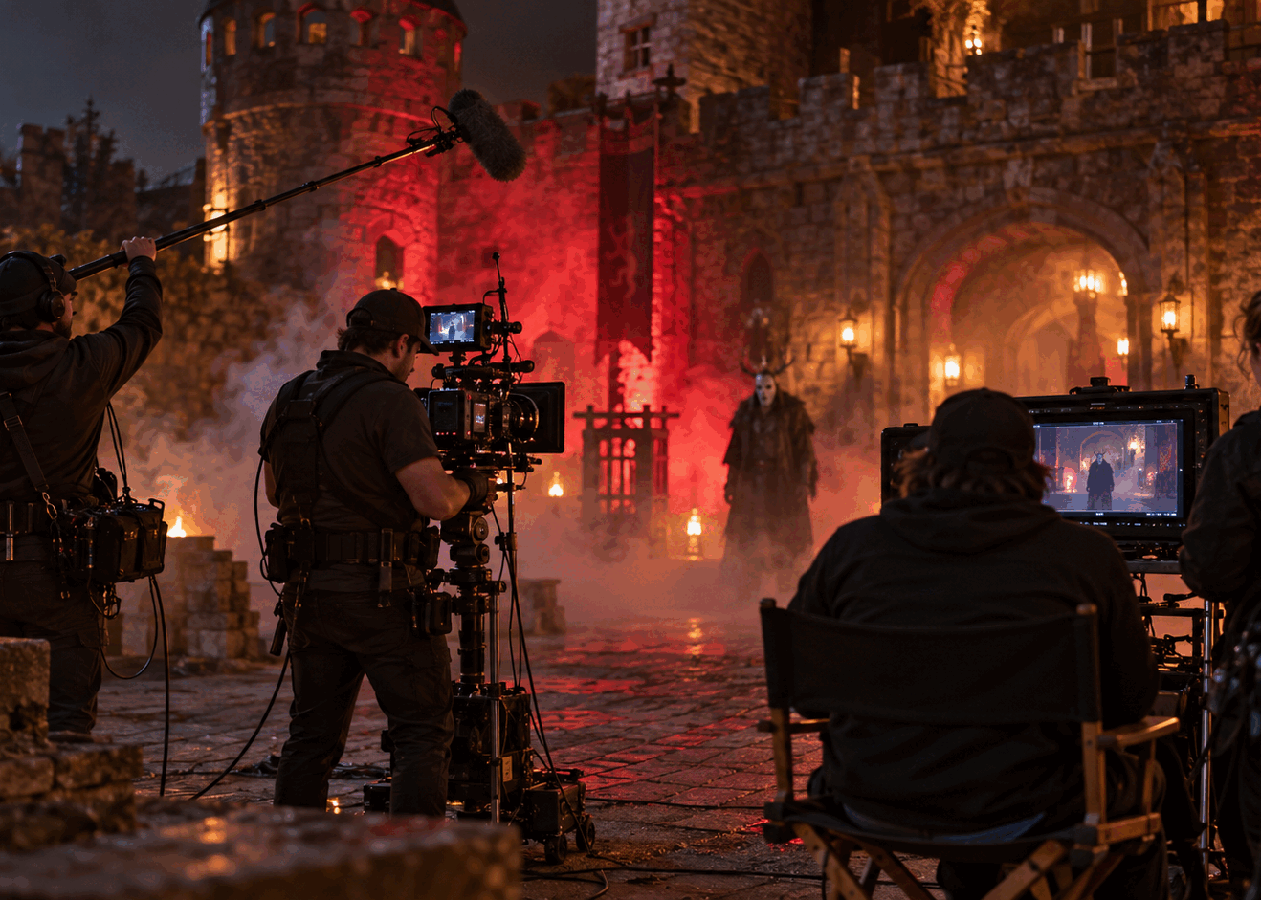
PRODUCTION ADVANTAGE
The contained world already has scale on screen.
LOCATION
The castle delivers practical sets, pathways, crowds and built in atmosphere without constructing a full horror world from scratch.
EXECUTION
The proof of concept can test the central camera clue, Nate and Mike’s chemistry and the Red Threads costume before the feature package is complete.
REDDYHOUSE PRODUCTIONS THE RED THREADS
10

Slide 12
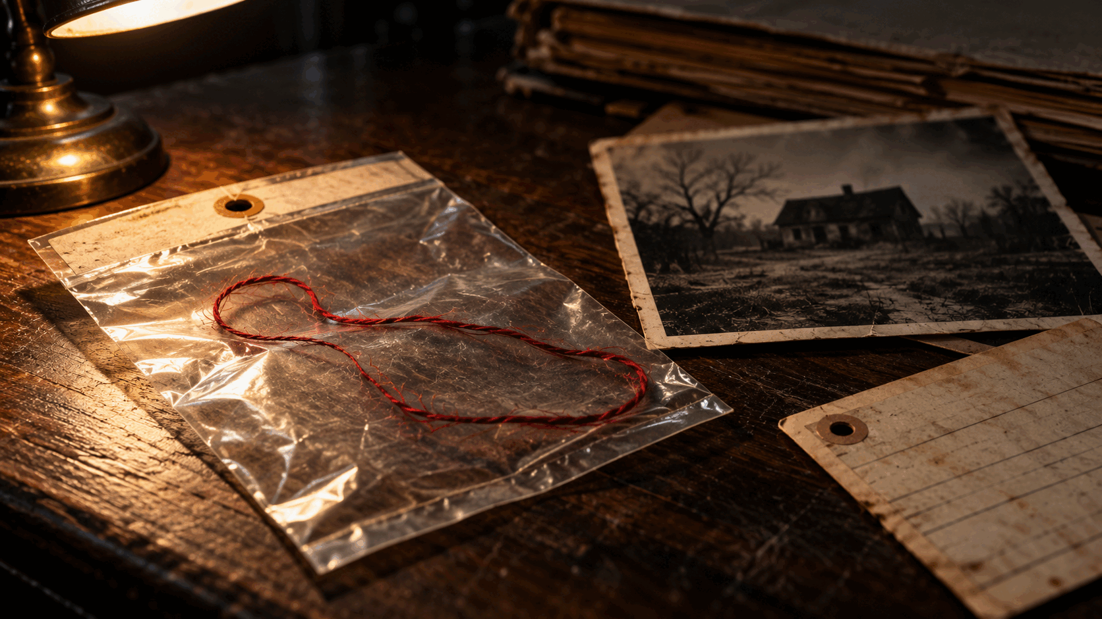
MARKET POSITION
A contained feature with a recognizable genre lane.
$4M to $6M
Working production target
Designed for practical locations, limited company moves and a controlled effects plan.
The budget remains a development target until the screenplay, schedule and department estimates are locked.
REDDYHOUSE PRODUCTIONS THE RED THREADS
11

Slide 13
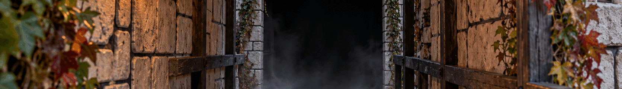
CURRENT POSITION
The project has a clear path to a finance ready package.
IN PLACE
NEXT
Feature concept and screenplay development. Castle relationship pending final agreement. Visual development footage. Reddyhouse Productions project site.
Complete the creator rewrite. Shoot the proof of concept. Lock the location agreement. Build the schedule, budget and production team around the finished script.
REDDYHOUSE PRODUCTIONS THE RED THREADS
12

Slide 14
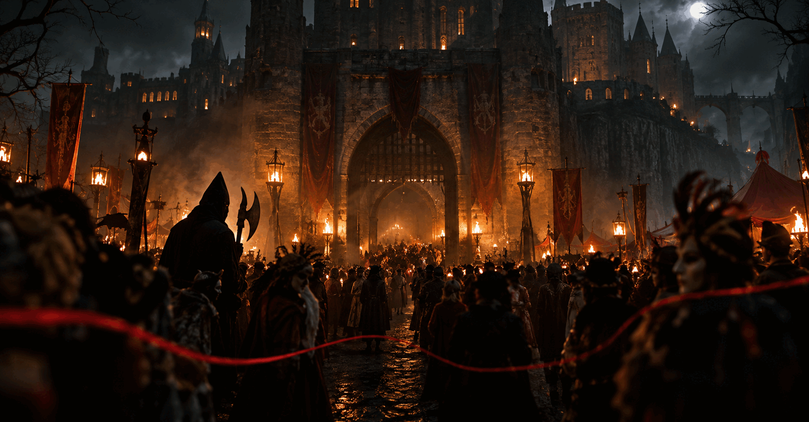
THE ASK
Help turn the eighth figure into a feature.
Seeking a producing partner
Development and proof of concept financing
Packaging and distribution guidance
OG Harve
Writer and Producer
Reddyhouse Productions
reddyhouseproductions.com
theredthreadsmovie.com
Notes:
Contact and project websites current as of September 2026.

